Slide 1

Project Analytix-OFW
GENDER INEQUALITY ANALYTICS
Comparative Analysis of Gender Inequality Measures applied to Leading OFW Destinations and the Philippines
J. Norman Pasamonte
and
David Pasamonte
25 Sep 2022
Notes:
Hello. My name is Norman Pasamonte and I’m the team lead for Analytix-OFW.
My professional work includes two stints abroad as an OFW in Bahrain and in Saudi Arabia. And so, the issue of labor migration, and now with gender inequality, resonates strongly with me. This is my motivation in joining the hackathon.
I am aided by my team mate and youngest son, David, who is interested in data analytics. He produced the video of this pitch deck.

Slide 2
Contents
Problem
Solution
How It Works
Impact
References
Future Plans
This pitch deck can be accessed from:
<https://drive.google.com/drive/folders/1-lktw7hyxM6rIV7x6rfGK5ozP3-THsrO>
Notes:
Our presentation outline is based on a suggestion from one of our Hackathon mentors of what worked for his team in their winning entry.
First we identify the problem which we want to solve.
Next we propose a Solution, How it Works and its Impact and contribution.
We show references used in the study
And finally we present our future plans.

Slide 3
Problem
Shortage of formal research on Gender Inequality
that focuses on the plight of OFWs.
Most existing gender inequality studies are of foreign
origin and focus on either global or country perspective
where OFW representation is marginal.
Linked to the theme: “Decent work in destination
countries for women.”
Notes:
During the development of our proposal, we surveyed all the data sources suggested in the Hackathon and then analyzed our current strengths and analytical tools we can use.
Then we started pouring through some of the popular literature on gender migration and inequality studies.
We noticed a shortage of formal research on Gender Inequality that focuses on the plight of our OFWs.
Most gender inequality studies are of foreign origin and focus on global or country perspective where OFW representation is marginal.
So we thought of a solution linked to the theme:
Decent work in destination countries for women.

Slide 4
Solution
Contribute a research paper to create awareness in the
Philippines (first) and the world (later on).
Research Paper on “Comparative Analysis of Gender Inequality Measures
Applied to Leading OFW Destinations and the Philippines”
Create an gender inequality analytics dashboard to showcase
how analytical (statistical) approaches can be presented in
an appealing manner.
Notes:
So our solution is write a research paper to create awareness in the Philippines and perhaps the world.
Because we are using an integrated development environment in R to develop the research paper, a side benefit is that an analytics dashboard can also be developed using the same R code.
Creating a dashboard can showcase the power of analytics to researchers during conference presentations or to interested users browsing the host website.

Slide 5
How It Works
Data sources:
Gender Inequality Measures (UNDP, WEF)
UN Sustainable Development Goals (UNDP)
OFW data (PSA)
Analytical Tools:
Excel (data collection)
R Studio (plots, correlations, panel regression)
R markdown (knitting of preliminary research paper)
Flexdashboard (dashboard)
Notes:
So how does it work?
First we need Data from the
United Nations Development Programme,
World Economic Forum and the Philippine Statistics Authority.
We assume that the data is ethically sourced, since its sources are reputable international and local government agencies.
Next, we install Analytical Tools in our laptops.
Excel for data collation and cleaning
R Studio to write code and develop plots, correlations and run panel regression
R Markdown is used to knit the R code and create the preliminary research paper.
A Flexdashboard template is used to create the dashboard in RStudio.

Slide 6
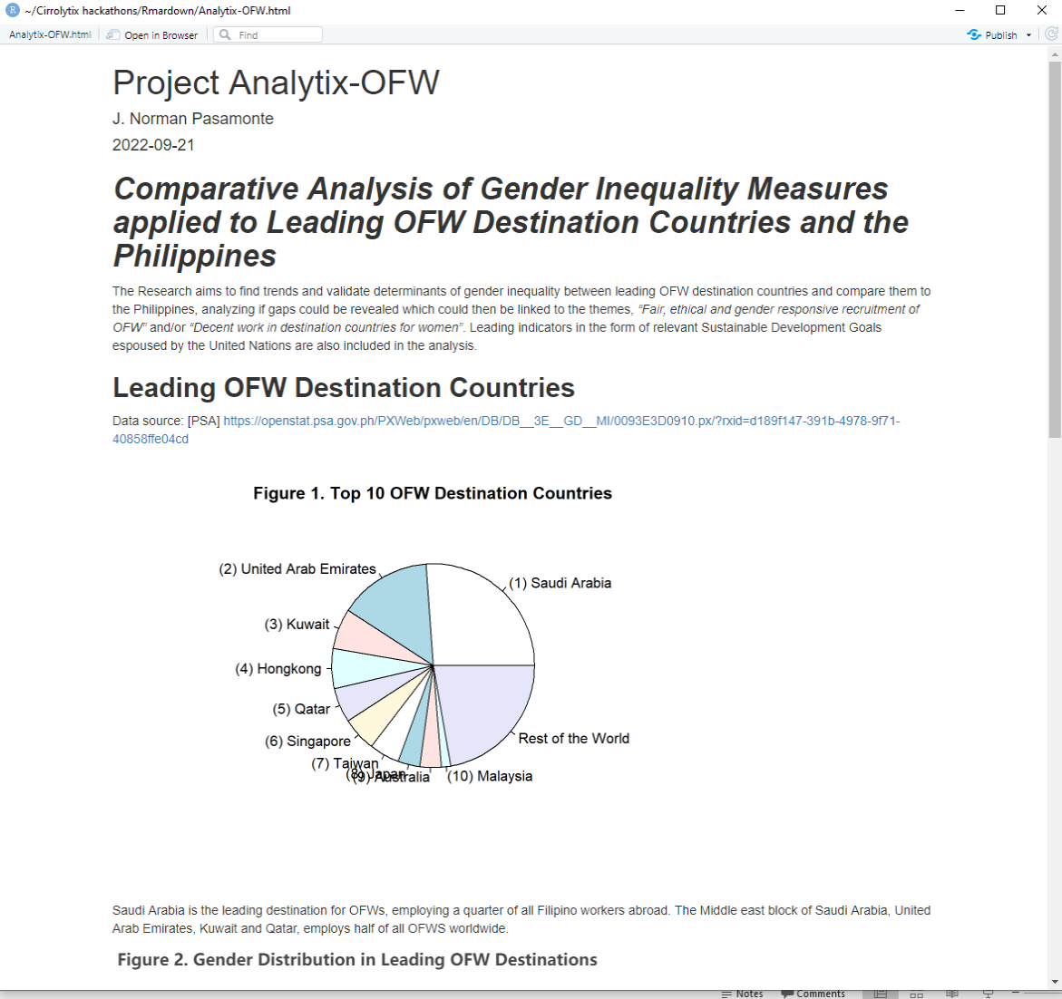
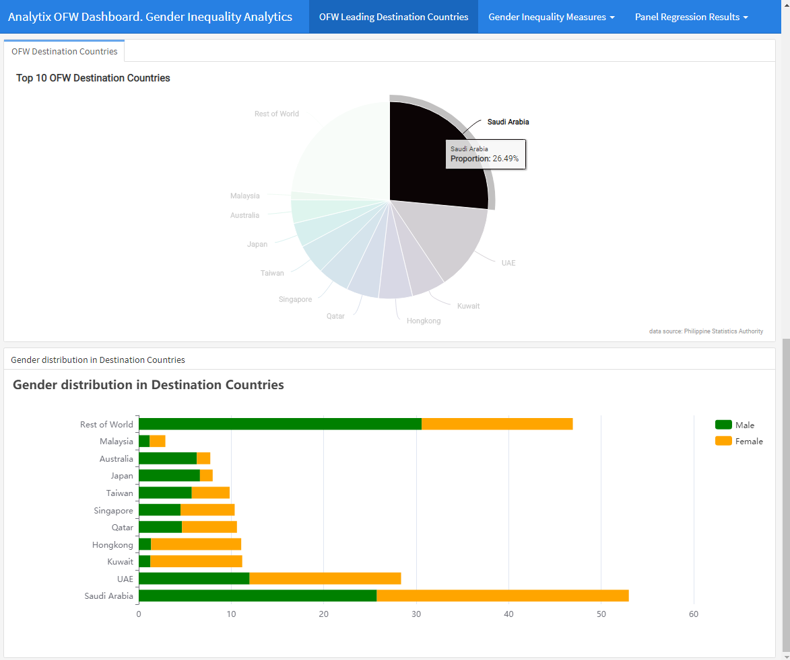
How It Works (continued… Output)
Research Paper produced from R markdown.
Dashboard from Flexdashboard.
Notes:
Here we show sample screenshots of the output.
Rmarkdown has limited formatting capability but since it can integrate the R code used in the analysis, it is used to produce the preliminary research paper. The final research paper will be using the ASA template for publication and will take more time to complete.
On the right side is the dashboard with some interactive capabilities.

Slide 7
How It Works (continued… Some Insights)
Gender inequality index puzzling results for Saudi Arabia.
Global Gender Gap Index appears to be the most stable measure.
Notes:
Now we would like to show you partial insights derived from the data.
On the left side there are line graphs and correlation plots of the 3 gender inequality measures used. Gender Development Index (GDI). Gender Inequality Index (GII). Global Gender Gap Index (GGGI). The graphs compare the Philippines and Saudi Arabia.
The Philippines show results consistent with gender inequality theory. However, Saudi Arabia shows strange results. The drop in GII starting from year 2012 indicates tremendous improvement towards gender equality. However this does not reflect reality. If we look at the events of 2013 in Saudi Arabia, there was civil unrest, arrests and human rights violations as reported by the Human Rights Watch.
On the right side is another insight which is that the Global Gender Gap Index is the most stable among the three. Its desirable characteristics could be harnessed in developing a local OFW gender inequality index.

Slide 8
Impact
Awareness within academic, research community
Publication of research paper
Presentation in conferences
Awareness and policy change within relevant government agencies (DFW, OWWA)
Possible collaboration to capture more detailed data with deeper gender sensitive and social dimensions for analysis and action.
Local (DFW)
OFW digital data collection platform and analytical framework
OFW Gender Inequality Index
Foreign (countries with significant numbers of labor migrants)
Data collection is designed to address lack of data and allows the ability to derive other indicators like OFW sentiment. Hosting a central repository can also help other data analysts/hackathoners develop creative apps to address other OFW gender issues.
Notes:
Our solution hopes to create awareness in the academic, research community and the local agencies which could effect policy change.
We also propose a collaboration with government agencies to develop a digital data collection strategy and an OFW gender inequality index.
These two ideas, we can start locally and then replicate abroad with countries having a significant labor migrant population.

Slide 9
References
Beneria, L., Permanyer, I.,(2010). The Measurement of Socio-economic Gender Inequality Revisited, Development and Change, 41:3, pp.375-399.
Kabeer, Naila. (1994). Reversed Realities: Gender Hierarchies in Development Thought. London, UK: Verso.
Klasen and Schüler. (2011). Reforming the Gender-Related Development Index and the Gender Empowerment Measure: Implementing Some Specific Proposals. Archived 2013-12-02 at the Wayback Machine, Feminist Economics, 17:1, 2011.
March, Candida, Smyth, Ines and Mukhopadhyay, Maitrayee. (1999). A Guide to Gender-Analysis Frameworks. London: Oxfam Publishing.
Moser, Caroline O.N. (1993). Gender Planning and Development: Theory, Practice, and Training. London: Routledge.
Parker, Rani. (1993) Another Point of View: A Manual on Gender Analysis Training for Grassroots Workers. New York: UNIFEM.
Permanyer, I.,(2011). Are UNDP Indices Appropriate to Capture Gender Inequalities in Europe? Archived 2020-09-11 at the Wayback Machine, Social Indicators Research, pp. 1-24.
Poole, M. A., & O’Farrell, P. N. (1971). The Assumptions of the Linear Regression Model. Transactions of the Institute of British Geographers, 52, 145–158. <https://doi.org/10.2307/621706>
Wikipedia contributors. (2022, September 3). Global Gender Gap Report. In Wikipedia, The Free Encyclopedia. Retrieved 01:15, September 7, 2022, from https://en.wikipedia.org/w/index.php?title=Global_Gender_Gap_Report&oldid=1108194719.
Wikipedia contributors. (2022, June 11). Gender Inequality Index. In Wikipedia, The Free Encyclopedia. Retrieved 01:12, September 7, 2022, from https://en.wikipedia.org/w/index.php?title=Gender_Inequality_Index&oldid=1092592140.
Zulfikar, Rizka, (2018). "Estimation Model And Selection Method Of Panel Data Regression : An Overview Of Common Effect, Fixed Effect, And Random Effect Model," INA-Rxiv 9qe2b, Center for Open Science. <https://ideas.repec.org/p/osf/inarxi/9qe2b.html>
Notes:
These are the references used and cited in the study.

Slide 10
Future Plans
Next 3 months
Next 6 months
Next 9 months
Next year
Refine research paper
and dashboard.
Pitch ideas to DFW:
OFW digital data
collection and
analytical framework.
Development
of OFW Gender
Inequality Index.
Look for avenues for
possible publishing
of research paper
and/or presentation
to conferences.
Develop tools and initial
data collection platform
and statistical basis for
OFW Gender Inequality
Index.
Publish and present in conferences.
Pitch ideas to government
bodies/NGOs of countries with
significant numbers of migrant workers
and present demos of
Digital collection platform
OFW Gender Inequality Index
framework.
Continue/complete
development
(version 1) of:
Digital collection
platform
OFW Gender
Inequality Index
framework
Notes:
Finally, we outline our future plans.
We identify two points:
Our research paper to reach publication quality and publish and/or present it in conferences.
Our data analytic platform strategy for digital data collection and the development of an OFW gender inequality index, collaborating with local government agencies and then possibly abroad.

Slide 11

Thank you for listening.
This Photo by Unknown Author is licensed under CC BY-NC-ND
Notes:
And with that we end our presentation.
Thank you for listening.

